Slide 1

Natural Language Processing
Sentiment Analysis
Using NLP
Automated Multi-Class Text Classification for Emotion Detection
Machine Learning
Model Evaluation
TF-IDF Vectorization
Linear SVC Performance
Project by group 3

Slide 2
Navigation
Overview
01
Business Context
02
Problem Statement
Understanding the value of automated sentiment analysis for organizations
Challenges in analyzing unstructured text data at scale
03
Project Objectives
04
Data Understanding
Building an end-to-end NLP pipeline for emotion classification
Dataset exploration and quality assessment
05
Model Evaluation
06
Key Insights
Comparing classifier performance across metrics
Critical findings from the analysis
07
Conclusions & Recommendations
Strategic guidance for implementation and future improvements

Slide 3
Business Context
The Value of Automated Sentiment Analysis
Faster Understanding
Data Challenge
Enable rapid comprehension of public and customer sentiment at scale
Modern organizations collect large volumes of unstructured textual data from customer feedback, social media posts, support tickets, and online reviews. Manual analysis is time-consuming, inconsistent, and difficult to scale.
NLP Solution
UX Monitoring
This project builds an end-to-end Natural Language Processing solution that automatically classifies text into four emotion categories: positive, negative, none, and unknown.
Improve tracking of user experience through continuous sentiment tracking
Business Impact
By automating text classification, organizations can detect satisfaction trends, identify neutral messages, filter ambiguous content, and prioritize responses to high-impact feedback.
Data-Driven Decisions
Support strategic decision-making through actionable insights

Slide 4
Problem Statement
The Challenge of Text Analysis at Scale
Unstructured Data Complexity
Organizations rely on large volumes of unstructured text data to understand customer opinions. However, this data is difficult to analyze at scale because it is noisy, inconsistent, and highly variable in language, structure, and quality.
Key Challenge
Design and evaluate an end-to-end NLP pipeline that can reliably:
Class Imbalance Issue
Transform raw text into structured features
The dataset exhibits a strong class imbalance, with the "none" category representing a significantly larger proportion compared to other classes. This makes it difficult to build models that perform reliably across all categories, especially for minority classes.
Accurately perform multi-class emotion classification
Mitigate effects of class imbalance
Minimize information leakage during evaluation
Data Quality Concerns
Raw text contains noise such as irrelevant tokens and informal language, which can negatively affect model performance if not properly cleaned and transformed into meaningful numerical representations.
Goal: Establish a robust and reproducible workflow for text preprocessing, feature extraction, and supervised learning that generalizes well to unseen data and supports real-world business use cases.

Slide 5
Data Understanding
Dataset Exploration and Quality Assessment
Dataset Source
Exploration Goals
This project uses a dataset of tweets from Data.World to build a model that classifies the presence and polarity of emotions directed at brands or products.
The goal of this stage is to understand the dataset's structure and content. This includes:
Reviewing the features and data types
Identifying potential quality issues
Detecting missing values and duplicates
Dataset Components
Analyzing class imbalance patterns
Raw Tweet Text
Identifying corrupted or anomalous entries
Unprocessed social media content
Brand/Product Reference
Target entity mentioned in tweet
Insight: By exploring the data at this stage, it is possible to detect quality concerns and inform decisions for text cleaning, preprocessing, and subsequent NLP model development.
Emotion Label
Positive, negative, none, or unknown

Slide 6
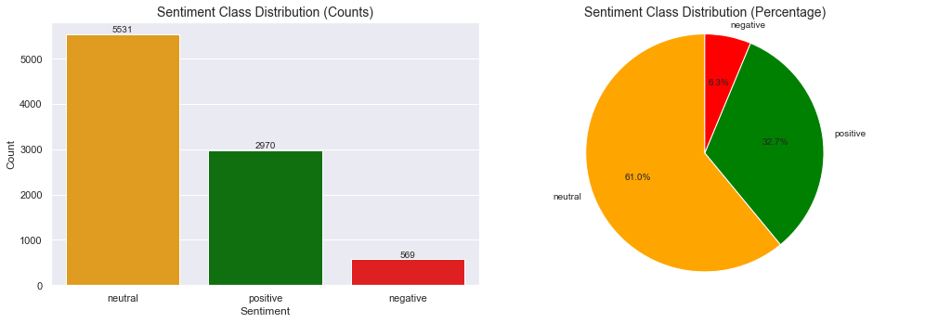
Pie Chart representation of sentiment class distribution
Class Distribution
Insight 01
The dataset is highly imbalanced, with the majority of tweets falling under the neutral or positive sentiment categories.
The Negative class is the Minority class
Implication: Most users express neutral or favorable opinions rather than negative ones, requiring special handling for minority classes.

Slide 7
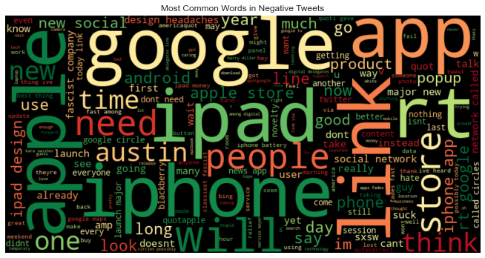
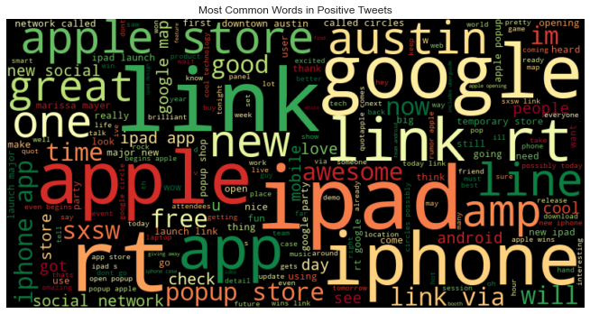
Word Clouds
Word Cloud
These word clouds show the most frequent terms in negative, positive, and neutral tweets. Larger words appear more often, giving us insight into the language patterns associated with each sentiment

Slide 8
Project Objectives
Building a Comprehensive NLP Pipeline
Main Objective
Develop an end-to-end Natural Language Processing pipeline for automated multi-class text classification that accurately categorizes text data into positive, negative, none, and unknown emotion classes, and evaluates the performance of different machine learning models on an imbalanced dataset.
Specific Objectives
Research Objectives
Success Criteria
Explore dataset structure and emotion label distribution
Investigate how different linear classifiers perform on imbalanced multi-class problems
Models correctly perform multi-class emotion classification
Clean and preprocess raw text by removing noise
Examine TF-IDF feature engineering effects, including n-grams
At least one model demonstrates improved balanced performance across minority classes
Transform text using TF-IDF vectorization
Build ML pipelines integrating vectorization and classification
Determine which model provides the most balanced and reliable performance
Workflow avoids data leakage by separating training and testing data
Train and evaluate Logistic Regression, Naïve Bayes, and Linear SVM
Assess performance using accuracy, precision, recall, and F1-score

Slide 9
Key Insights
Critical Findings from the Analysis
Class Distribution
Model Performance
Data Cleaning Impact
Insight 01
Insight 02
Insight 03
The dataset is highly imbalanced, with the majority of tweets falling under the neutral or positive sentiment categories.
Among the models tested, Linear SVC performed the best, achieving the highest accuracy and macro F1 score.
Preprocessing steps significantly improved model accuracy and reduced noise in the text data.
Implication: Most users express neutral or favorable opinions rather than negative ones, requiring special handling for minority classes.
Implication: Linear SVC can effectively distinguish between positive, negative, and neutral sentiments, making it the optimal choice.
Implication: Proper text preprocessing is essential for achieving reliable sentiment classification results.
Preprocessing Steps Applied
Lowercasing
URL Removal
Mention Removal
Hashtag Removal
Standardize text
Remove links
Remove @user
Remove #tags
Punctuation Removal
Number Removal
Tokenization
Stopword Removal
Clean symbols
Remove digits
Split into words
Remove common words

Slide 10
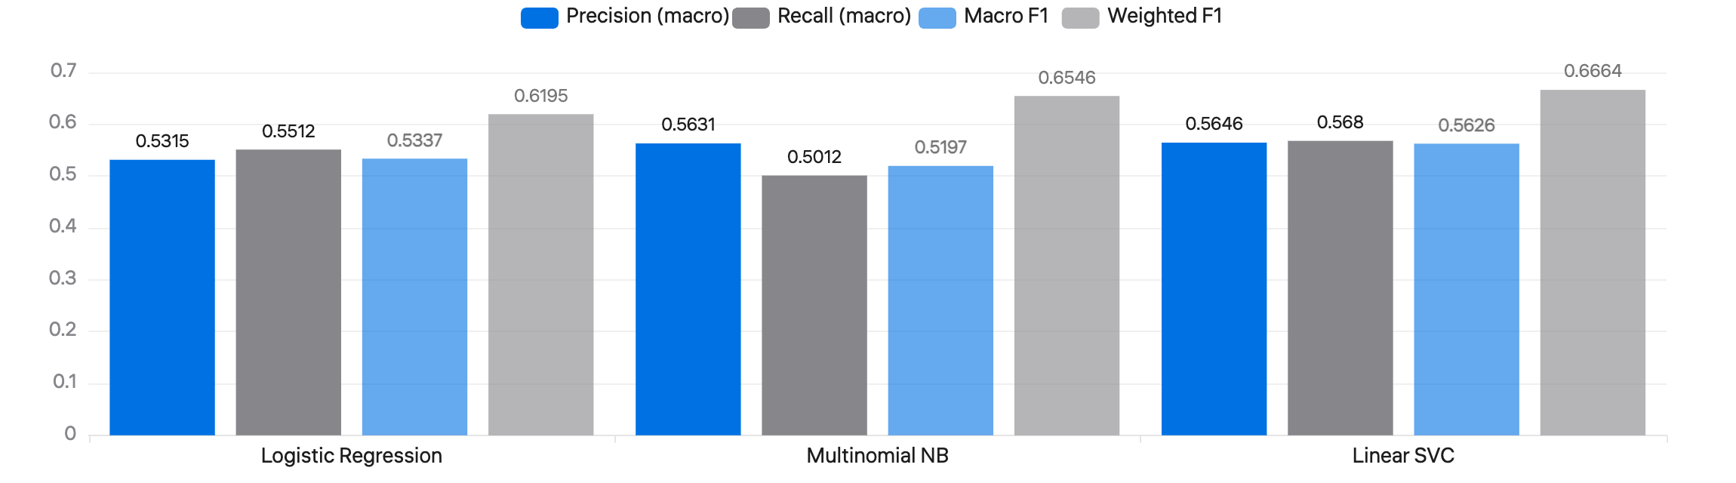
Model Evaluation
Final Model Performance Comparison
The performance of three tuned models—Logistic Regression, Multinomial Naive Bayes, and Linear SVC—was evaluated on the test set using multiple metrics:
Logistic Regression
Multinomial NB
Linear SVC
Macro F1
0.5337
Macro F1
0.5197
Macro F1
0.5626
Weighted F1
0.6195
Weighted F1
0.6546
Weighted F1
0.6664
Reasonable baseline performance
Competitive performance
Best balanced performance

Slide 11
07 / Conclusions
Project Summary and Achievements
Project Success
The sentiment analysis project successfully demonstrated the complete process of cleaning, preprocessing, and modeling textual data from tweets to classify them into positive, negative, and neutral emotions.
Key Takeaways
Text preprocessing is critical for accurate sentiment predictions
Appropriate model selection significantly impacts performance
Hyperparameter tuning optimizes model effectiveness
Best Performing Model
Balanced evaluation metrics are essential for imbalanced datasets
Among the models tested, Linear SVC achieved the best overall performance, making it the most effective choice for sentiment classification in this dataset.
Business Applications
The insights gained from this analysis can inform strategies for:
Monitoring public opinion
Understanding user behavior
Critical Success Factors
Data-driven decision-making
Brand reputation management
The results highlight the importance of careful feature extraction using TF-IDF and hyperparameter tuning to optimize model performance.

Slide 12
07 / Recommendations
Strategic Guidance for Implementation
Handle Class Imbalance
Error Analysis
Recommendation 01
Recommendation 03
Consider techniques to further improve performance on underrepresented sentiments:
Review misclassified examples to identify common failure cases:
Sarcasm detection challenges
Oversampling minority classes (SMOTE, ADASYN)
Slang and informal language
Undersampling majority classes
Ambiguous expressions and context
Class-weighted models to penalize misclassification
Consider augmenting the dataset
Use Advanced Embeddings
Deployment Considerations
Recommendation 02
Recommendation 04
Explore contextual embeddings for capturing semantic nuances:
For real-time sentiment monitoring:
BERT (Bidirectional Encoder Representations)
Package the model into a REST API
RoBERTa (Robustly Optimized BERT)
Integrate with dashboards for visualization
Better handling of subtle or sarcastic tweets
Set up reporting tools for actionable insights
Implement automated alerting systems

Slide 13

Thank You
This presentation demonstrated how Natural Language Processing can transform unstructured text data into actionable sentiment insights, enabling organizations to better understand and respond to customer opinions at scale.

